Slide 1
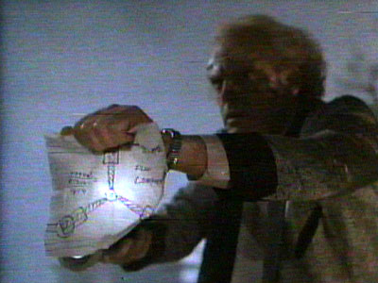
Not Flux Capacitor

Slide 2
B
A

Slide 3
Φ
Area = A
Field lines penetrating an area A perpendicular to the field
The product of EA is Φ
In general:
Φ_{E} = E A cos θ
E

Slide 4
Φ
But what if the field and the area are not perpindicular to each other?
We have an angle θ that describes the angle between the area, A, and the field direction.
Area = A
E
θ

Slide 5
Φ
Sometimes you will see θ defined with respect to a vector that is normal (perpendicular) to the surface
It is the same θ, just a different way to say it.
Area = A
E
θ
^
n

Slide 6
Electric Flux
Φ_{E} = E A cos θ
The perpendicular to the area A is at an angle θ to the field
When the area is constructed such that a closed surface is formed, use the convention that flux lines passing into the interior of the volume are negative and those passing out of the interior of the volume are positive

Slide 7
Projection of Area
Side View
Front view
Original Area
Original Position

Slide 8
Projection of Area
Side View
Front view
Original Area
Original Position
New Position
Projected Area
θ

Slide 9
Curved Surfaces
Region of
Interest

Slide 10
Curved Surfaces

Slide 11
Closed Surface
Negative Flux
Positive Flux

Slide 12
Coordinates for a Sphere
z
θ
P
ϕ
x
y

Slide 13
Coordinates for a Sphere
z
P
θ
y
Side View

Slide 14
Coordinates for a Sphere
y
P
ϕ
x
Top View

Slide 15
Element of Length in θ
z
Δl = r Δθ
Δθ
r
x
Side View

Slide 16
Check Element of Length in θ
z
Δl = r Δθ
Δθ
r
x
Side View

Slide 17
Element of length in ϕ
z
rsinθ
θ
P
ϕ
x
y

Slide 18
Element of length in ϕ
x
Δl = rsinθ Δϕ
Δϕ
y
rsinθ
Top View

Slide 19
Check Element of length in ϕ
y
Δl = rsinθ Δϕ
Δϕ
x
rsinθ
It is the circumference of the smaller circle
Top View

Slide 20
Element of Area
z
Δϕ
ΔA = rsinθΔθrΔϕ
Δθ
x
y

Slide 21
Check Element of Area
z
Δϕ
Δθ
x
y

Slide 22
Charge in Closed Surface
Spherical Closed Surface
r
+
Q

Slide 23
z
E
y
x

Slide 24
Check Element of Area
z
Δϕ
Δθ
x
y

Slide 25
Check Element of Area
z
x
y

